Slide 1
School of Computer Science & Engineering
AI Application Development – IA1
MediClaimAISystem

Slide 2
Team members & roles
Team member name | Role
Yeshvanth T S | Team lead / Customer Contact Lead / Test Lead
Nandan P | Development Lead / Developer
Pruthviraj K | DevOps / GitHub / Product Build / Documents
Notes:
Talk about how they are managing their documents, how google docs does automatic versioning
As them what they know about Android and IoS versions

Slide 3
Problem Statement
Many patients and clinics face difficulty in managing
and submitting medical insurance claims efficiently.
Manual processes cause delays, errors, and lack of proper
tracking of claims.
Notes:
Talk about how they are managing their documents, how google docs does automatic versioning
As them what they know about Android and IoS versions

Slide 4
User/ Customer Understanding
We interacted with Hospital staff and users who file insurance claims
Most users still depend on manual or semi-digital methods
Common problems:
Time-consuming process
Errors in data entry
Difficulty in tracking claim status
Notes:
Talk about how they are managing their documents, how google docs does automatic versioning
As them what they know about Android and IoS versions

Slide 5
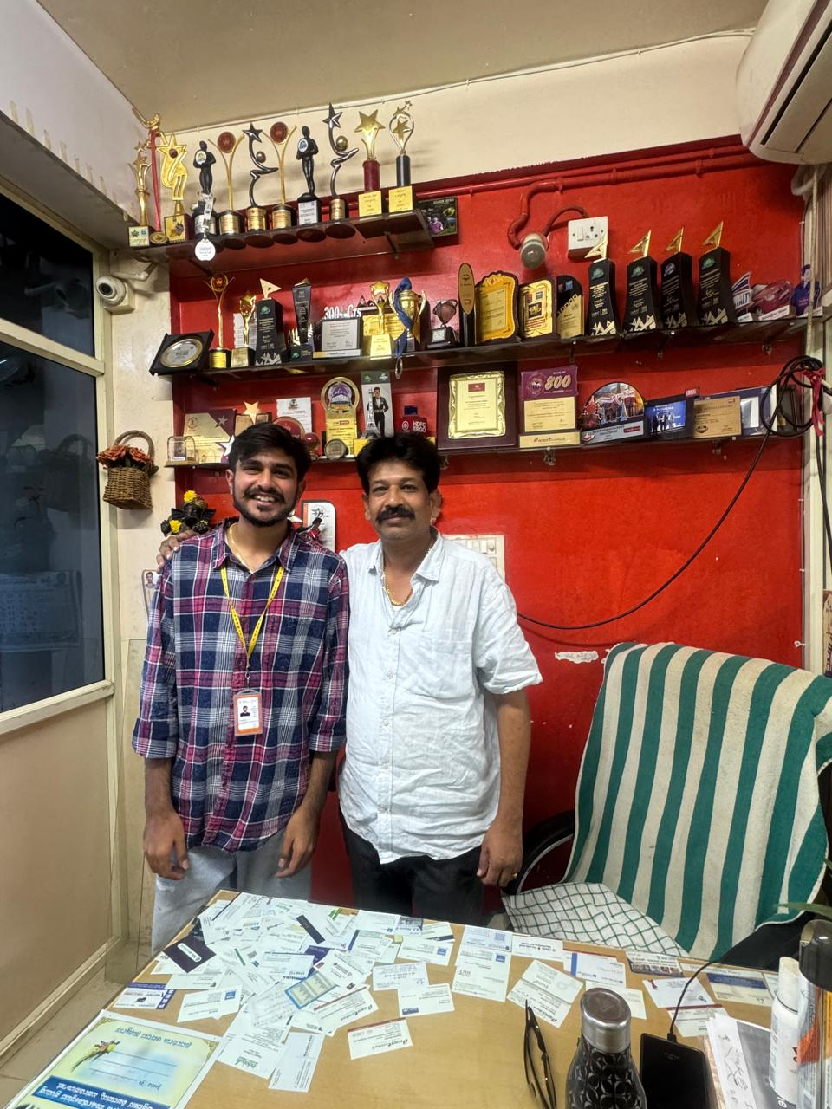
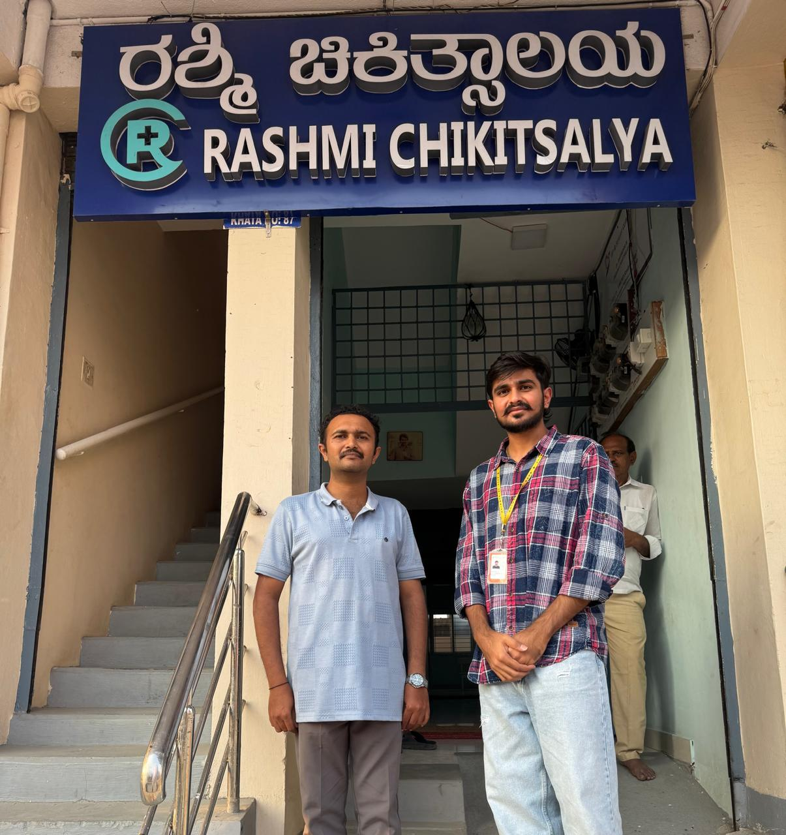
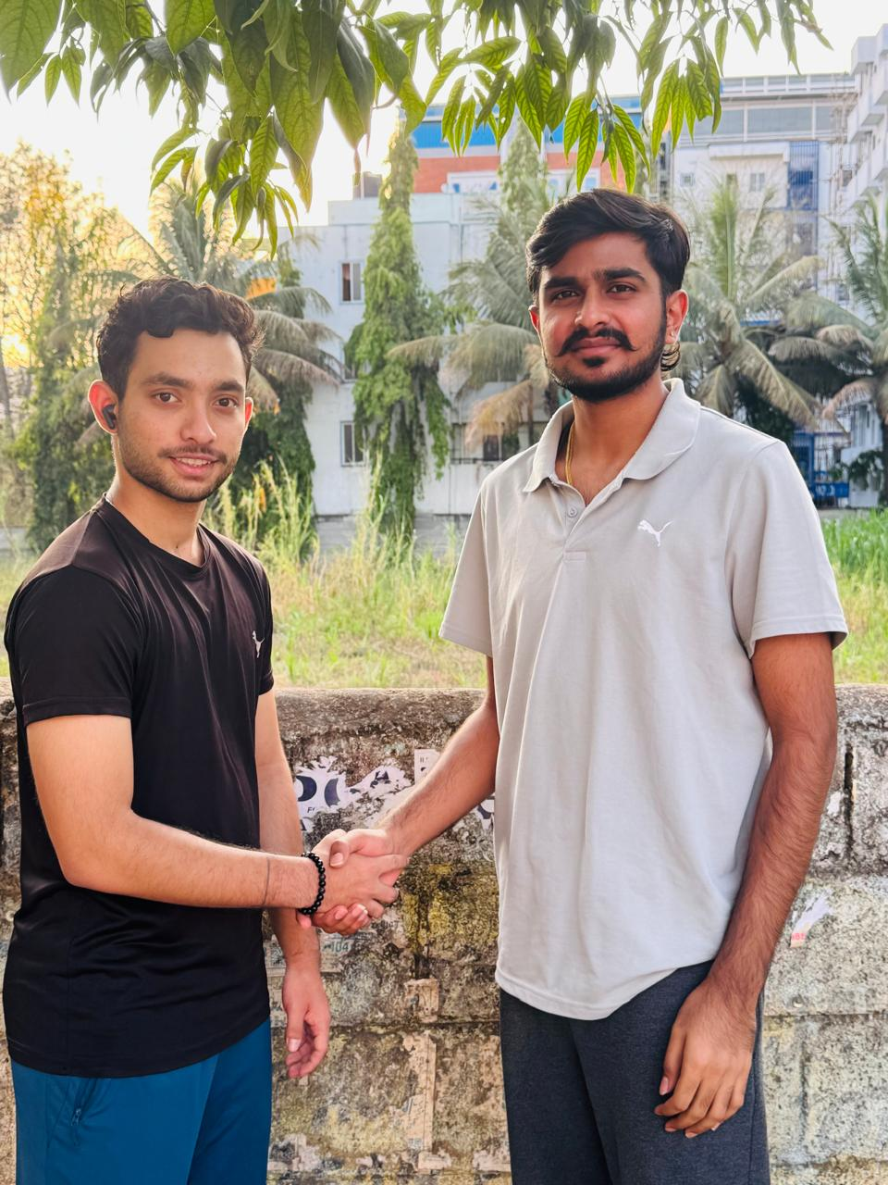
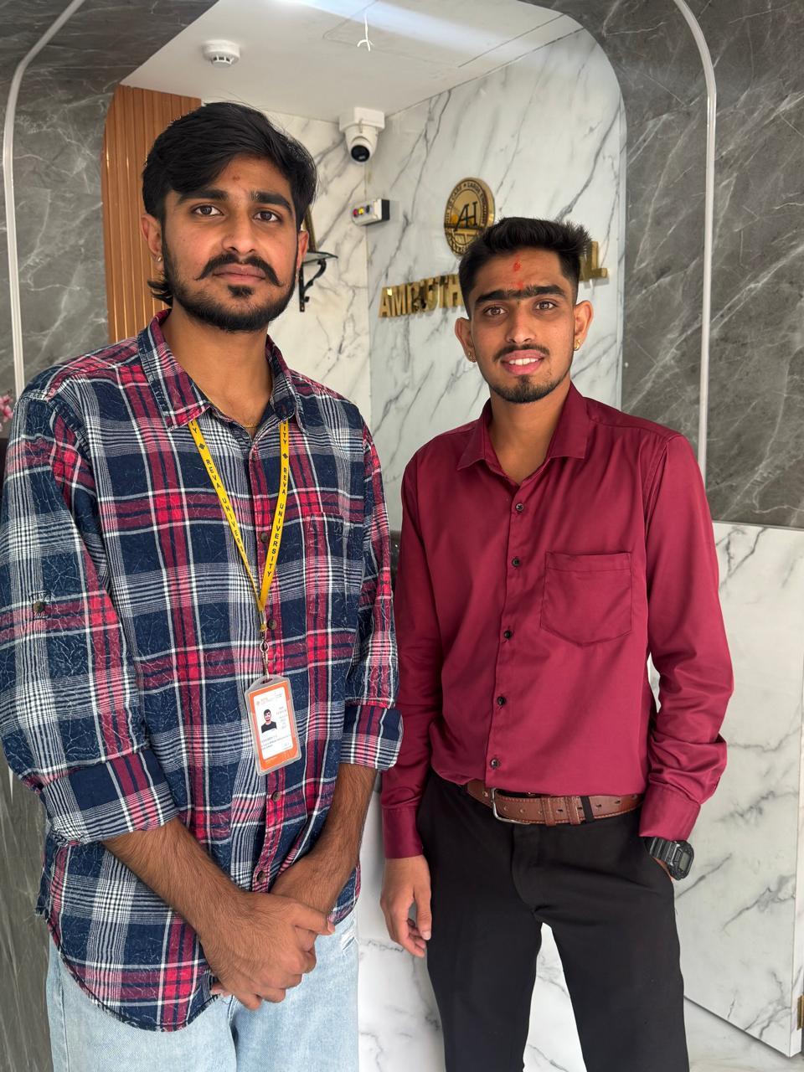
User interviews conducted to validate the problem statement

Slide 6
Ideal Customer Profile (ICP)
Demographic Profile:
Small clinics and hospitals
Patients aged 20–60 who use medical insurance
Insurance agents and clinic staff
Located in urban and semi-urban areas
Psychographic Profile:
Prefer simple and fast solutions
Want to reduce paperwork and errors
Need better tracking of claims
Not highly technical users
Notes:
Only stress on the 1st sentence – the definition
Come back to the 2nd sentence in the end as part of revision

Slide 7

Customer Persona (CP)
Name: Ravi Kumar Age: 35 Occupation: Hospital Assistant Location: Bengaluru
Demographic Profile:
Works in a small Hospital
Handles insurance claim documents
Uses basic computer and smartphone
Psychographic Profile:
Finds manual claim process time-consuming
Faces errors while entering data
Wants a simple and fast system
Needs easy tracking of claim status
Notes:
Only stress on the 1st sentence – the definition
Come back to the 2nd sentence in the end as part of revision

Slide 8
Product USP
Simple and user-friendly system for easy claim submission
Reduces manual errors and saves time
Provides quick processing and easy tracking of claims
Suitable for small clinics and non-technical users
Notes:
Only stress on the 1st sentence – the definition
Come back to the 2nd sentence in the end as part of revision

Slide 9
Use Cases & High level Requirements
Upload Documents Input: User uploads claim documents (images/PDF) Output: Documents are stored in the system
Extract Details Input: Uploaded documents Output: Extracted details like name, date, amount
Review & Edit Input: Extracted data Output: User can correct or confirm details
Submit Claim Input: Verified data Output: Claim is saved and processed
Track Claim Status Input: Claim ID / user request Output: Displays current status of claim
Notes:
Only stress on the 1st sentence – the definition
Come back to the 2nd sentence in the end as part of revision

Slide 10
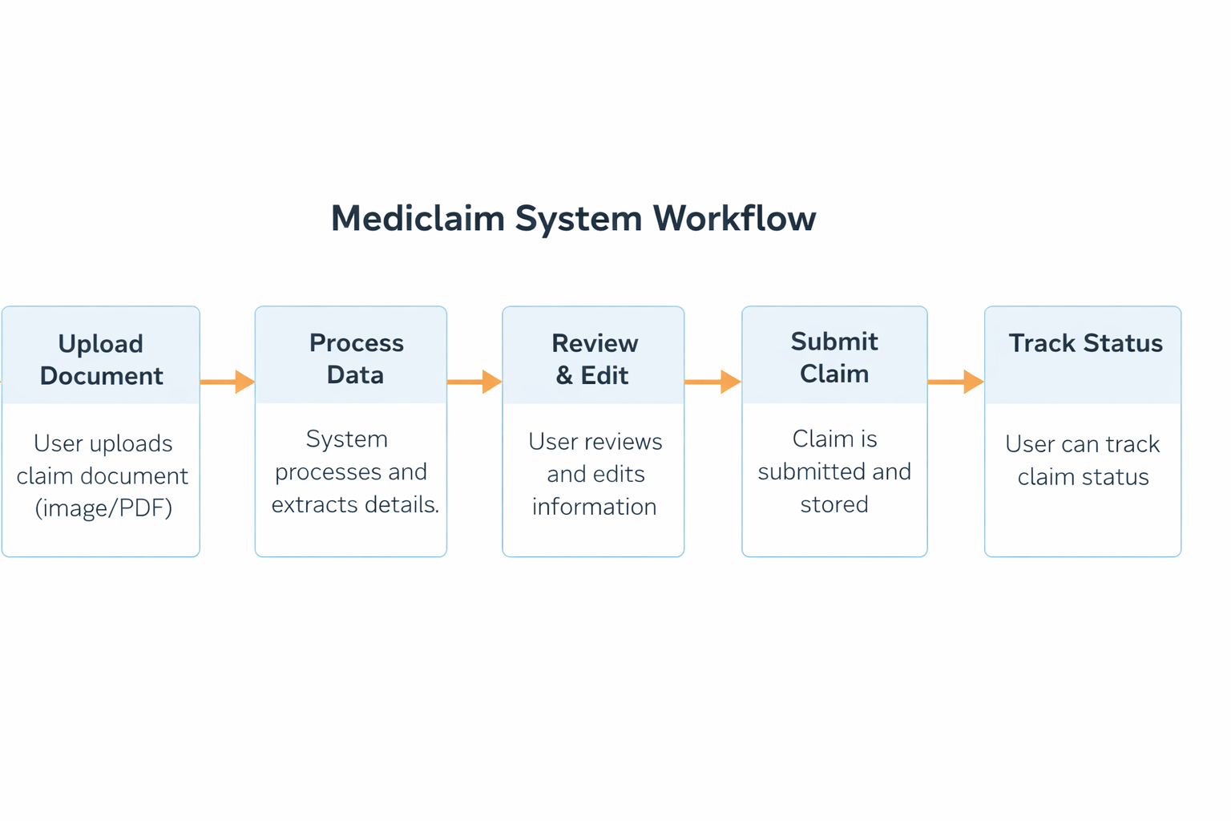
Proof of Concept (PoC) / Prototype Demo
Notes:
Only stress on the 1st sentence – the definition
Come back to the 2nd sentence in the end as part of revision

